Slide 1

Exploratory Data Analysis
Bank Marketing (Campaign)
January 14, 2023

Slide 2
TEAM MEMBER
Name: Giovanna Vieira
E-mail: giihvieira1703@gmail.com
Country: Brazil
College/Company: Hashtag Treinamentos
Specialization: Data Science

Slide 3
Problem Statement
Data Analysis
Data Cleaning
EDA
Final Recommendations
GitHub Repo Link
Agenda

Slide 4
Overview
ABC Bank wants to sell its term deposit product to customers and before launching the product they want to develop a model which help them in understanding whether a particular customer will buy their product or not (based on customer's past interaction with bank or other Financial Institution).
Solution
By analysing the dataset we will be able to convert this problem into a machine learning classification and build a model to predict whether a client will subscribe a term deposit or not.
Problem Statement

Slide 5
Data Analysis
21 Features
41188 rows
Assumptions:
The data seems to be cleaned and a little bit skewed, however you can see that the variables have outliers that need to be cleaned with data cleaning process.
There are no null values, but there are some "unknown" values.
We’ve got 41188 rows, some of the columns has 85% of the values repeated.
The value types seem to be correct but as said there are some “unknown” values.

Slide 6
Data Cleaning
The most used techniques to treat the data frame were:
Dropping columns and rows
Replacing missing values with the mode
Filling outliers with ffill/bfill based on interquantile range
Grouping text features that doesn’t appear many time
Cleaned dataset reduced from (41188, 21) to (40165, 18)

Slide 7
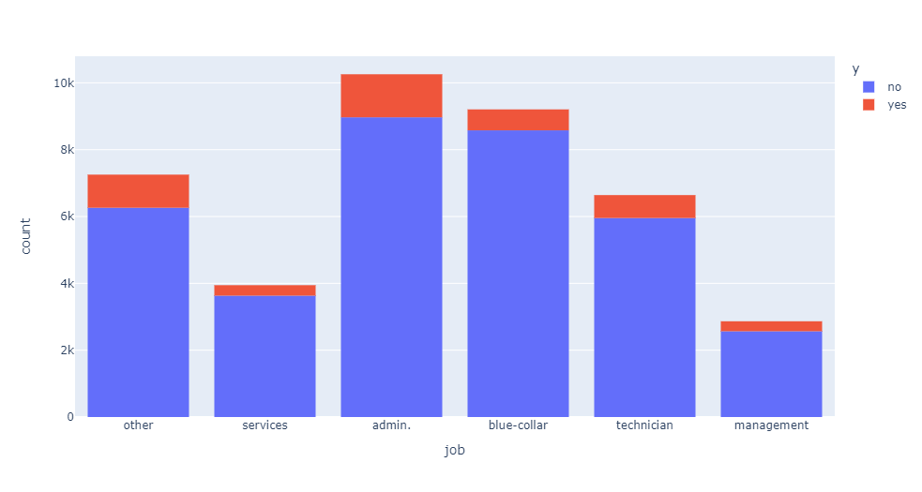
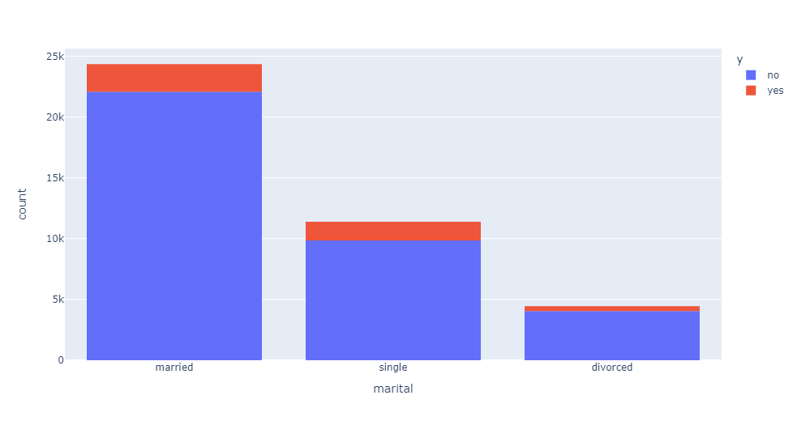
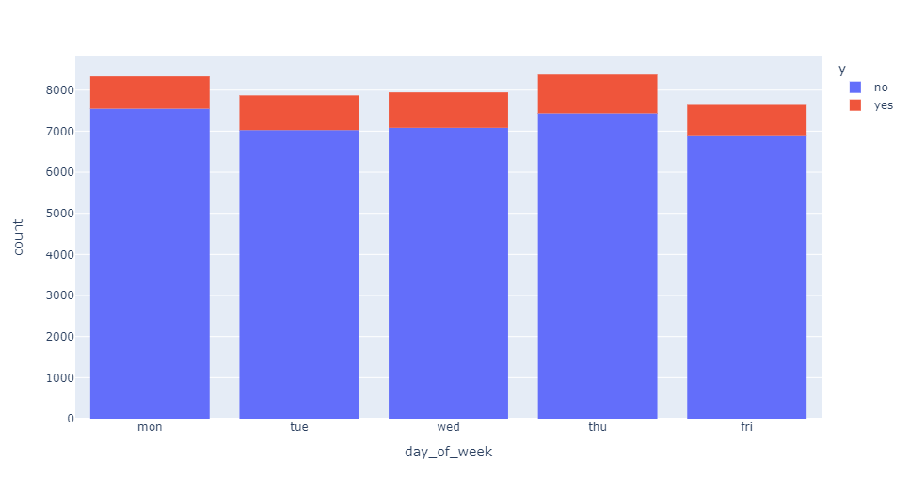
EDA – Categorical Attributes
Job: Highest number of subscriptions to a term deposit work on admin.
Marital: Most of the clients approached were married.
Day of Week: There's no significant difference in the numbers of clients approached and people subscribed.

Slide 8
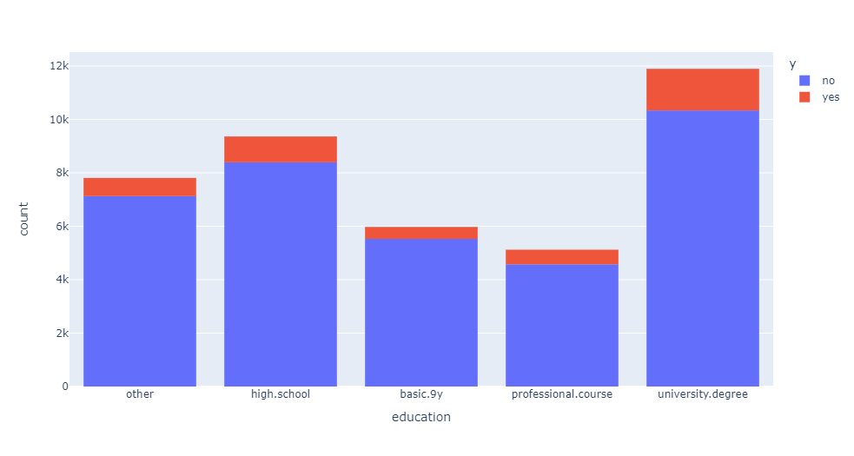
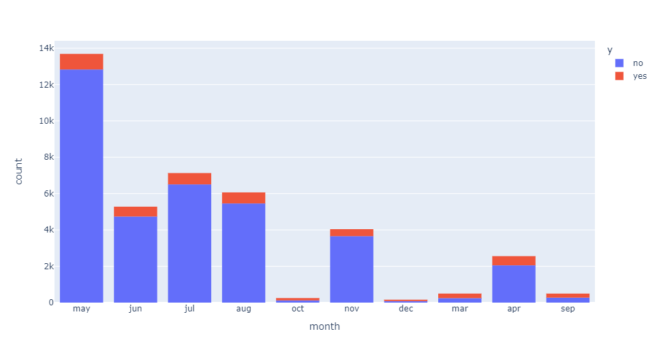
EDA – Categorical Attributes
Education: In the education column we can see that most people who has subscribed have a university degree.
Month: The last contact month of year was way bigger in may.

Slide 9
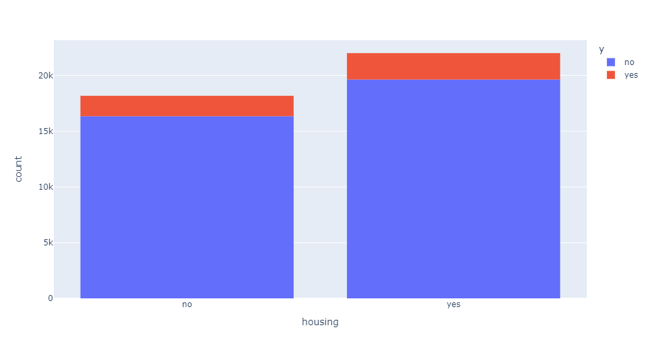
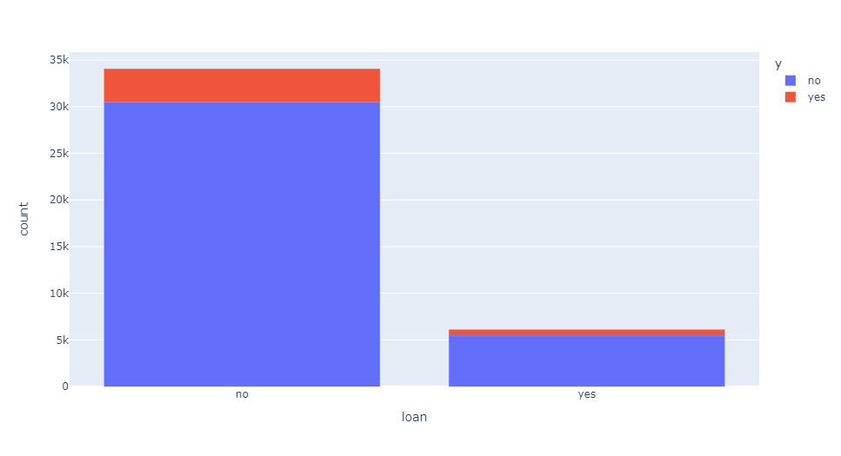
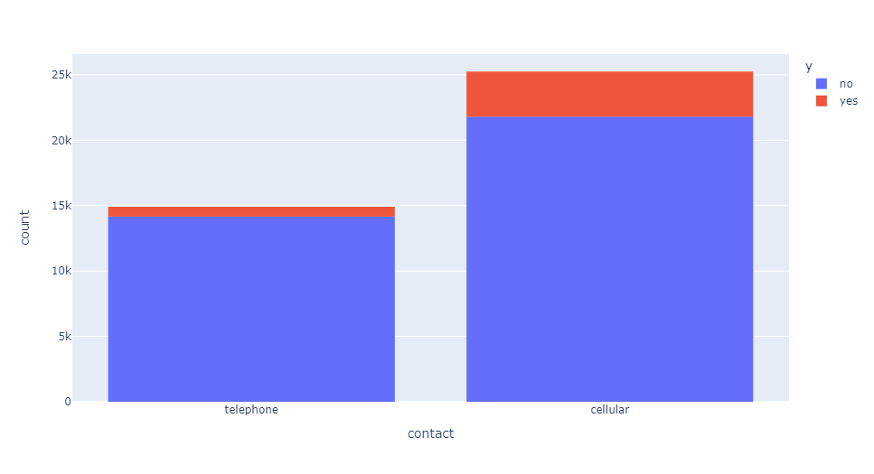
EDA – Numerical and Other Attributes
Housing: A housing loan does not have much of effect on the number of term deposits purchased.
Loan: Most of the clients approached did not have a personal loan.
Contact: The contact by phone seems to be more effective.

Slide 10
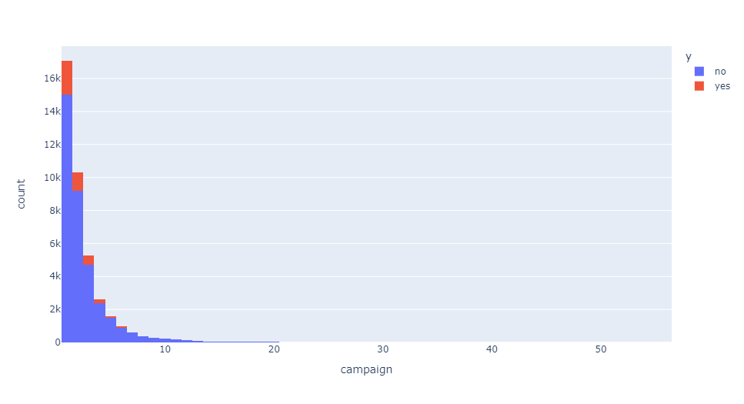
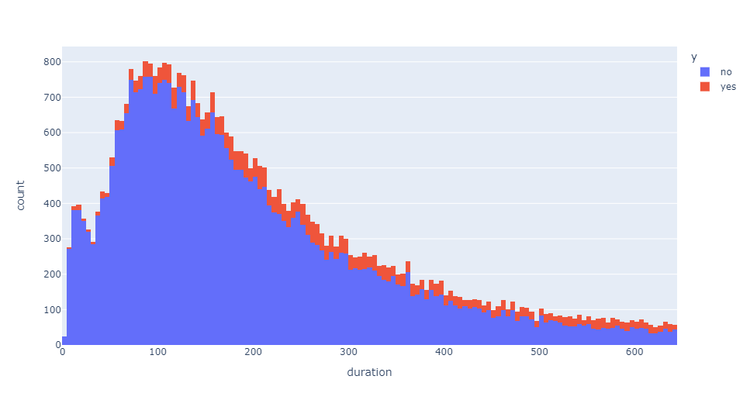
EDA – Numerical and Other Attributes
Campaign: Most of the numbers of contacts performed during the campaign and for the client were only once or twice.
Duration: The duration of the last contact is highly variated.

Slide 11
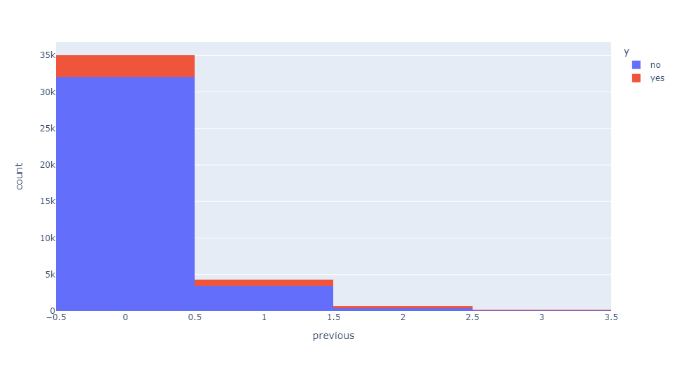
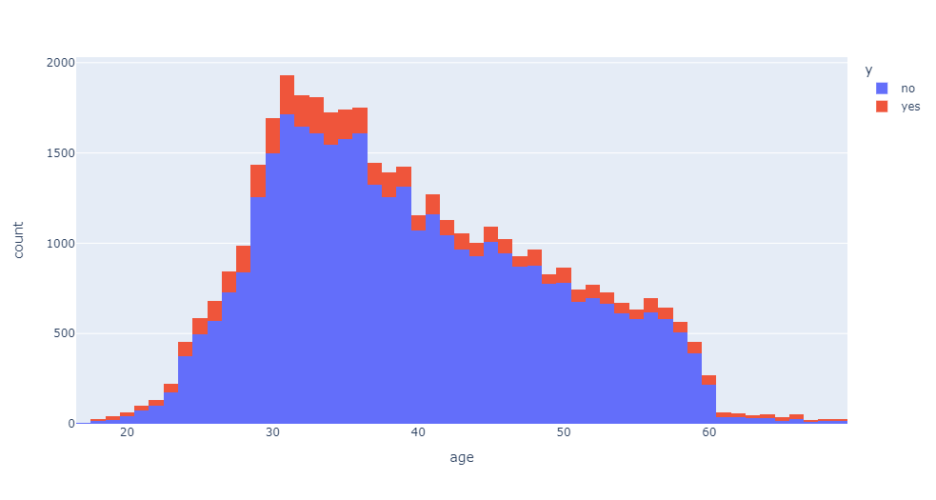
EDA – Numerical and Other Attributes
Previous: The number of contacts performed before this campaign and for a specific client was 0 in more than 80% of the cases
Age: Most of the people contacted was between 30 and 40 years old.

Slide 12
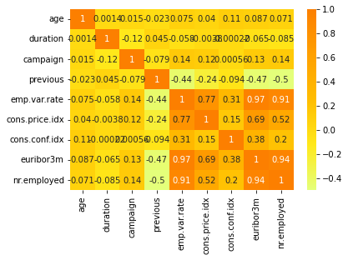
EDA – Numerical and Other Attributes
As we can see in this heatmap, the columns 'euribor3m', 'nr.employed' and 'emp.var.rate' are highly correlated.
You can see in the next page their graphics when comparing who did and who did not subscribe to a term deposit.

Slide 13
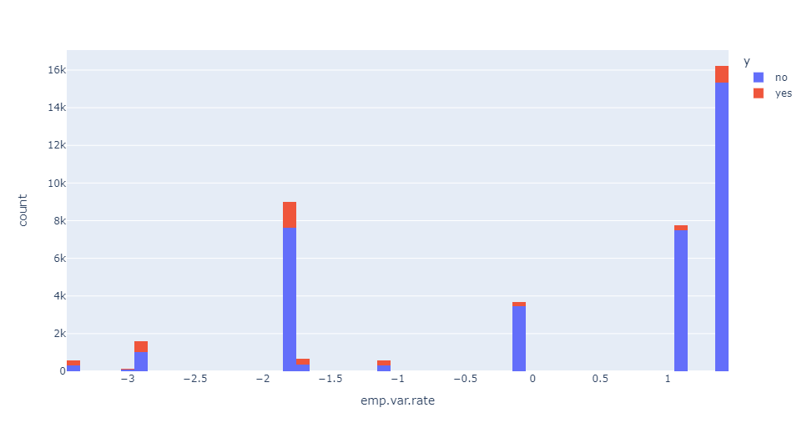
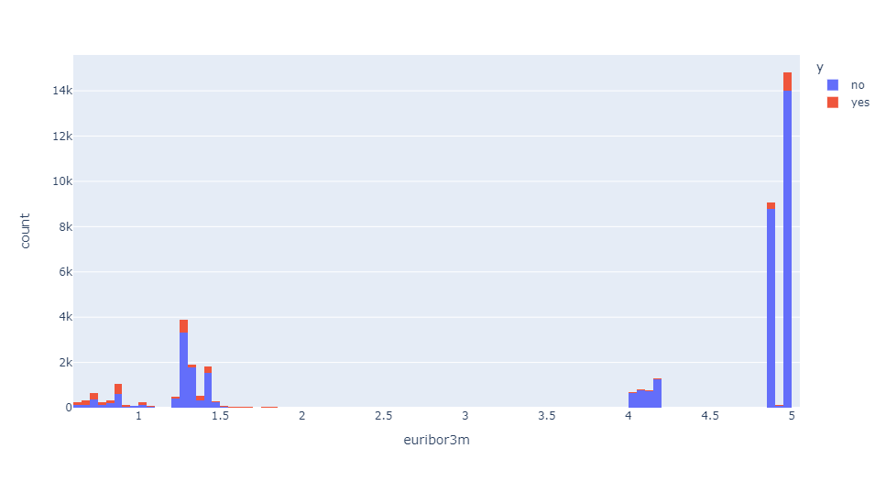
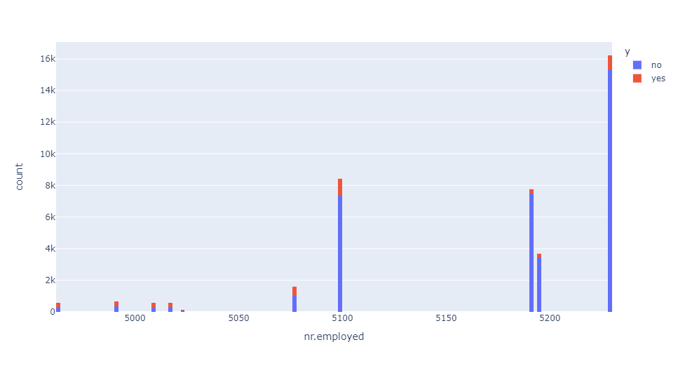
EDA – Numerical and Other Attributes

Slide 14
Final Recommendations
Now the project is almost finished and there are, basically, 2 important things left to do:
Perform features encode:
Turn words / yes or no / true or false into 0, 1, etc.
Get dummy variables
WoE encode
Explore classification models to predict if the clients have the tendence to subscribe to a term deposit:
Logistic Regression
Decision Tree Classifier
Random Forest Classifier
Gaussian NB (Naive Bayes)
SVC

Slide 15
GitHub Repo Link
https://github.com/sharuhinda/bank_marketing_campaign/tree/review
https://github.com/vgiih/EvolveData

Slide 16
Thank You!

